Slide 1
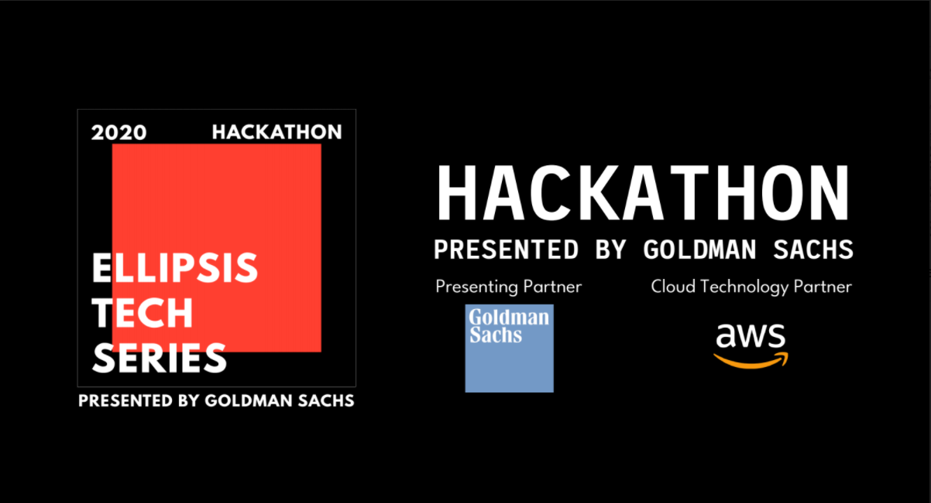
Investing For Youths (IFY)
Ode To Code
Caleb l Darryl l Jeremy l Kwan Yang l Wei Jie

Slide 2



Today’s youths require personalized solutions in order to make smart decisions regarding their personal finances
Issue
Information overload, lack of financial literacy, and an absence of suitable platforms have hindered youths in Singapore from effectively managing their personal finances
Key Question
How can we develop a platform that equips youths with personalized financial information according to their risk profile and goals which would empower them to make informed financial decisions for themselves
Solution Objectives
Our Solution – Investing For Youths (IFY)
A comprehensive & personalized solution for youths based on their risk tolerance and goals
1
Introduce a personalized platform for youths to learn more about personal finance
Telegram-bot questionnaire to ascertain user’s risk profile and personal goals
2
Ensure only the most relevant information is identified and presented
Website to showcase user’s hypothetical portfolio according to his/her individual profile
3
Have analysis of information retrieved to help youths make sense of it
Able to view personalized news and estimated hypothetical returns based on user’s portfolio

Slide 3
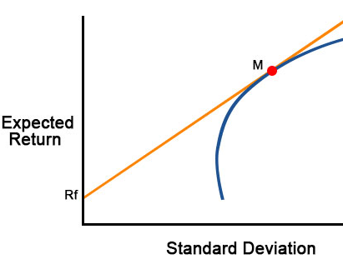
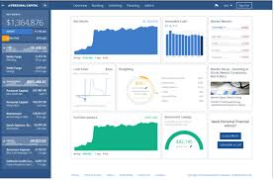

Investing For Youth(IFY) offers youths a platform with a personalized hypothetical portfolio that enables them to learn about investments
Telegram Questionnaire
Hypothetical Portfolio
Learning & Analysis of Results
User starts by accessing our telegram bot and answers some questions about personal finance
Next, the user accesses our website and enters his/her risk aversion coefficient
Lastly, the user will be presented with an overview of the portfolio and will be able to track its returns over time
Risk Taker
Risk Averse
1
5
Using Harry Markowitz’s Modern Portfolio Theory, and our “database” of 17 securities covering 4 beginner-friendly asset classes, we create a hypothetical portfolio for the user depending on his/her risk aversion coefficient
Based on our algorithm, the user will be assigned a risk aversion coefficient between 1-5, with 1 being a risk taker and 5 being a risk averse individual
News of the individual securities and beginner friendly articles explaining asset classes in the portfolio will also be shown real-time on the website to emulate actual learning and portfolio monitoring

Slide 4






Technology/Frameworks used
Solution Architecture
User Experience
Step 1. Assess Risk Tolerance
Trigger AWS lambda
Construct portfolio and upload portfolio.csv file to Amazon S3
Step 2. Access to customised portfolio
Investing For Youth Portal
Step 3. Obtain latest newsfeed on companies in the portfolio
Fetch portfolio.csv from Amazon S3 and conduct analysis
Store portfolio.csv

Slide 5
DEMO

Slide 6
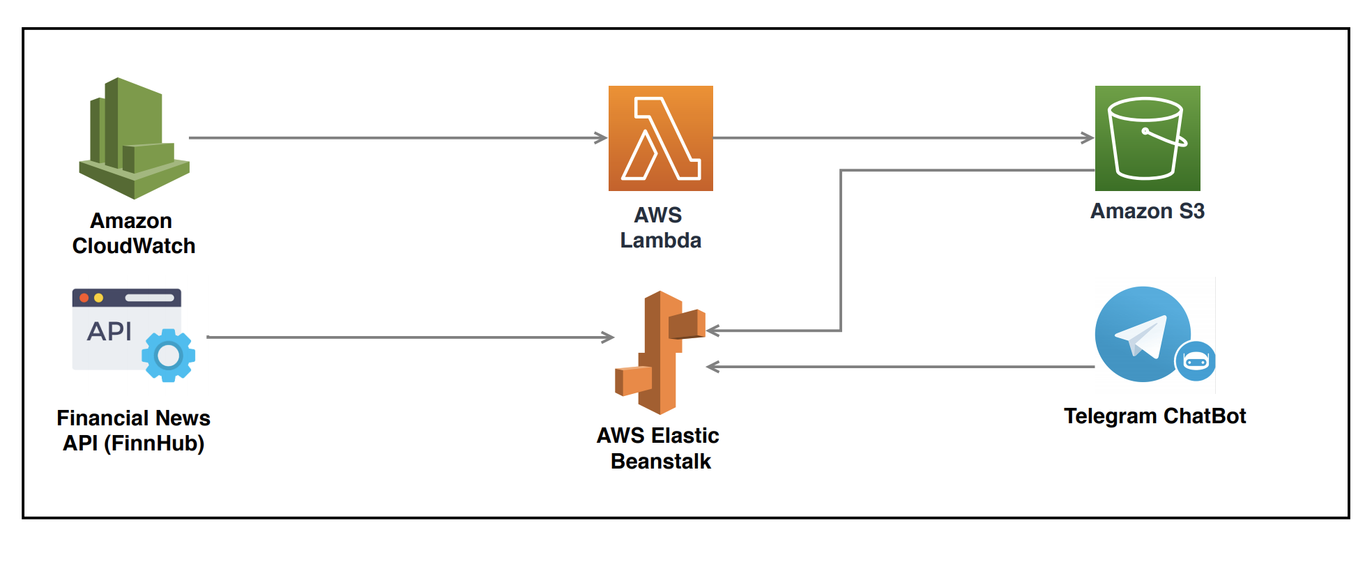
Solution Architecture
Solution Endpoint: http://deploy.eba-tcb5tsyy.us-west-2.elasticbeanstalk.com/

Slide 7
Investing For Youths (IFY) will be an innovative, beginner friendly, and seamless way to get youths started on financial literacy and investing
Issues
Information Overload leading to decision paralysis
Youths lack financial literacy to manage personal finances
Absence of comprehensive beginner friendly platforms
Question
How can OdeToCode create a platform to empower youths to make sound financial decisions for themselves?
Solution
Telegram chatbot to ascertain user’s risk profile
Generation of hypothetical portfolio
Monitoring of portfolio via real-time updates
After using our platform for a certain period of time, youths will be empowered and feel confident to make financial decisions for themselves. To scale, we can include links to regulated brokers in Singapore so youths can get into real investing after testing the waters via our platform and learning the basics
Impact

